Slide 1
LIVING LAB PROJECT
Course: Business Analysis
Instructor: Hoàng Anh Đào
Group 2
No. | Name | Student code | Position
1 | Phí Trà My | 2153010026 | Leader
2 | Nguyễn Hà Thanh Trúc | 2153010040 | Member
3 | Lê Hải Yến | 2153010046 | Presenter
4 | Lục Duy Toàn | 2153010039 | Member
5 | Hoàng Thị Sang | 2153010033 | Member
6 | La Thị Thuỳ | 2153010037 | Member
7 | Chẩu Thị Hương | 2153010016 | Member
8 | Đỗ Thị Ánh Ngà | 2153010028 | Presenter

Slide 2
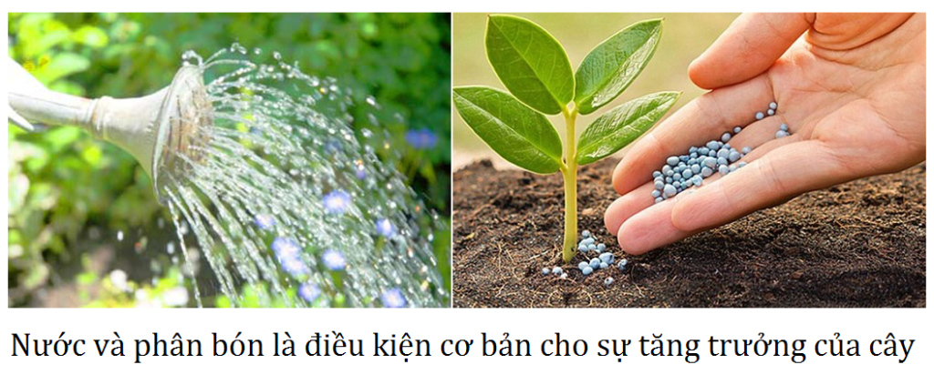
Living lab project:
TREE CARE IN PLACES THAT ARE LACK OF WATER

Slide 3
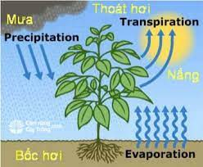
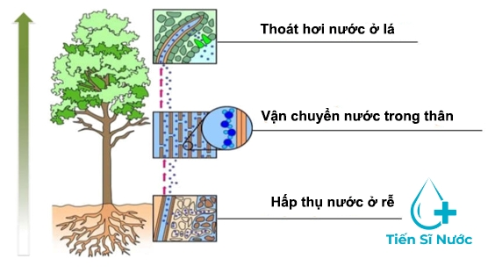
I. INTRODUCTION
Roles of water in plants

Slide 4
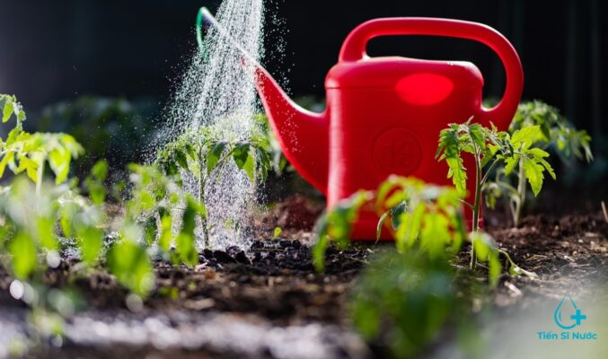
I. INTRODUCTION

Slide 5
II. SITUATIONS
Tan Trao University has a campus of more than 60 hectares with many large subdivisions. The area around A1 Hall and 14-8 Road is planted with more than 10,000 trees of all kinds, mainly flowers and ornamental plants that need more regular care than other perennial forestry plants.

Slide 6
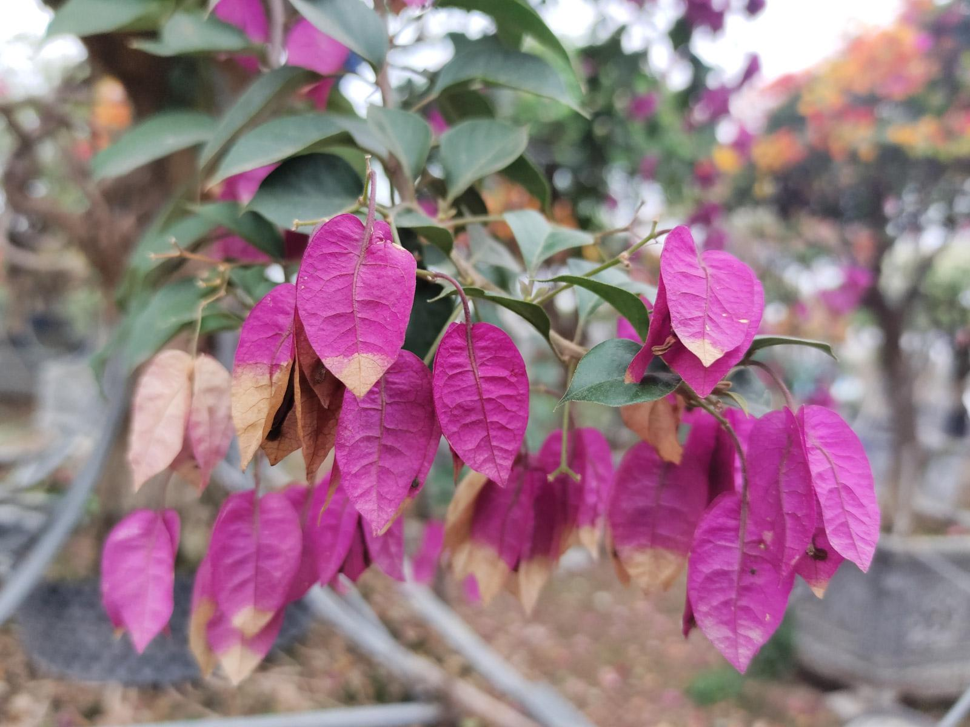
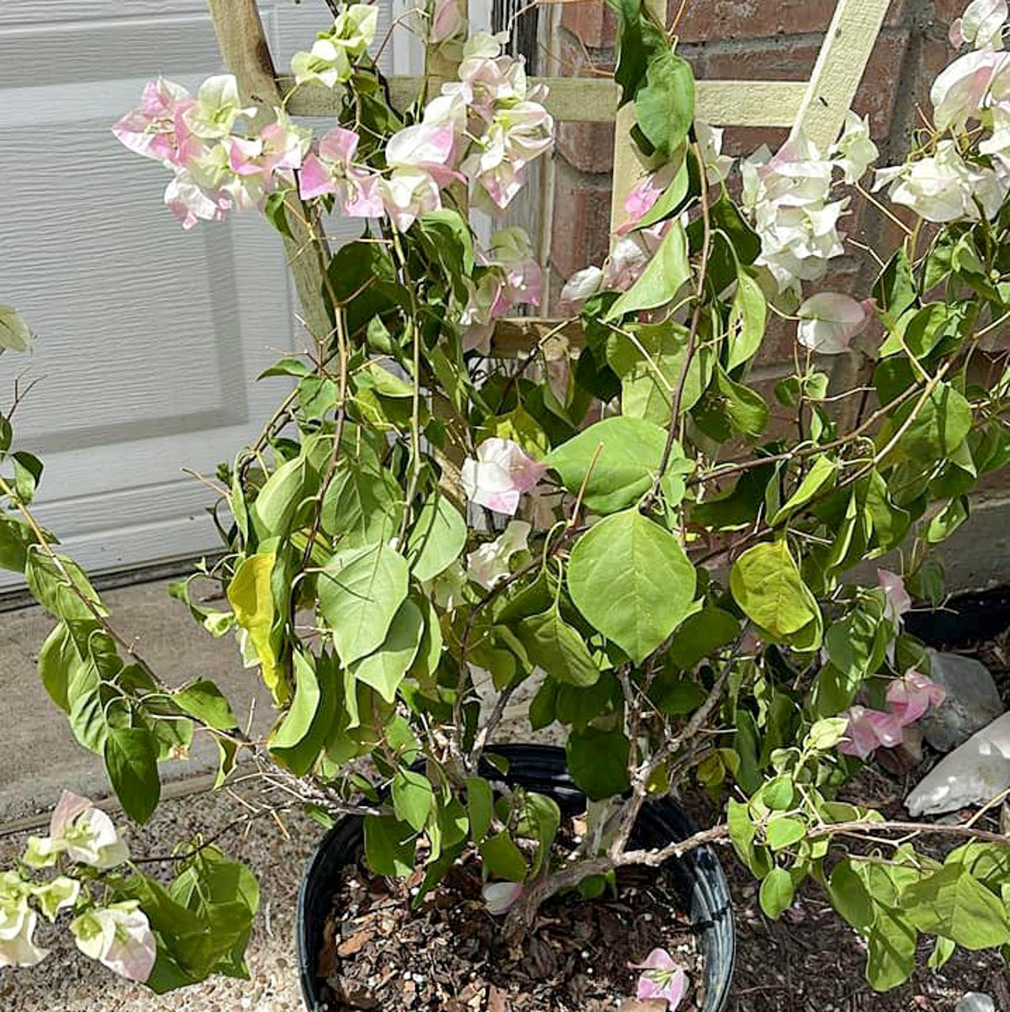
II. SITUATIONS
Currently, this area has no water source for trees, leading to many trees withering, dying, losing leaves, stunting and not being able to flower.

Slide 7
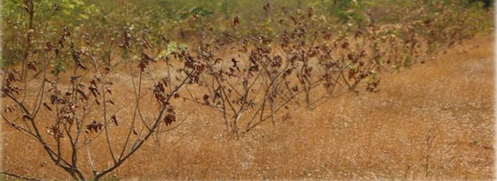
II. SITUATIONS
The problem at Tan Trao University in taking care of trees in green buildings and green parks is also a problem of many agencies, organizations and localities.

Slide 8
III. SOLUTIONS
Promote propaganda activities, raise awareness of students and the community about using recyclable waste, contributing to environmental protection
Organize volunteer activities to collect trees in order to plant additional at the place of dead, stunted, and underdeveloped trees.
Collect used plastic bottles and reuse them to make water containers and drip irrigation for plants.
Collaborate with experts in the university to research how to use organic waste as fertilizer for plants.

Slide 9
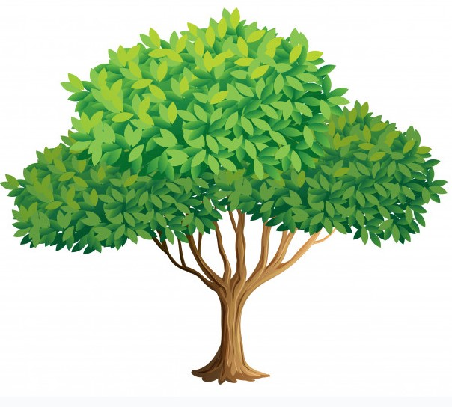
Proposed Model
Used plastic bottles contain water and nutrients for plants
(Drip irrigation)
Nylon around the base:
- Limit weeds
- Limit water evaporation

Slide 10
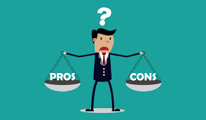
IV. ADVANTAGES AND DISADVANTAGES
ADs
The attention and facilitation of the school and mass organizations.
Consistent with the world's general trend of solving global problems.
DISADs
- Funds for project implementation.
- Time and effort to implement.

Slide 11
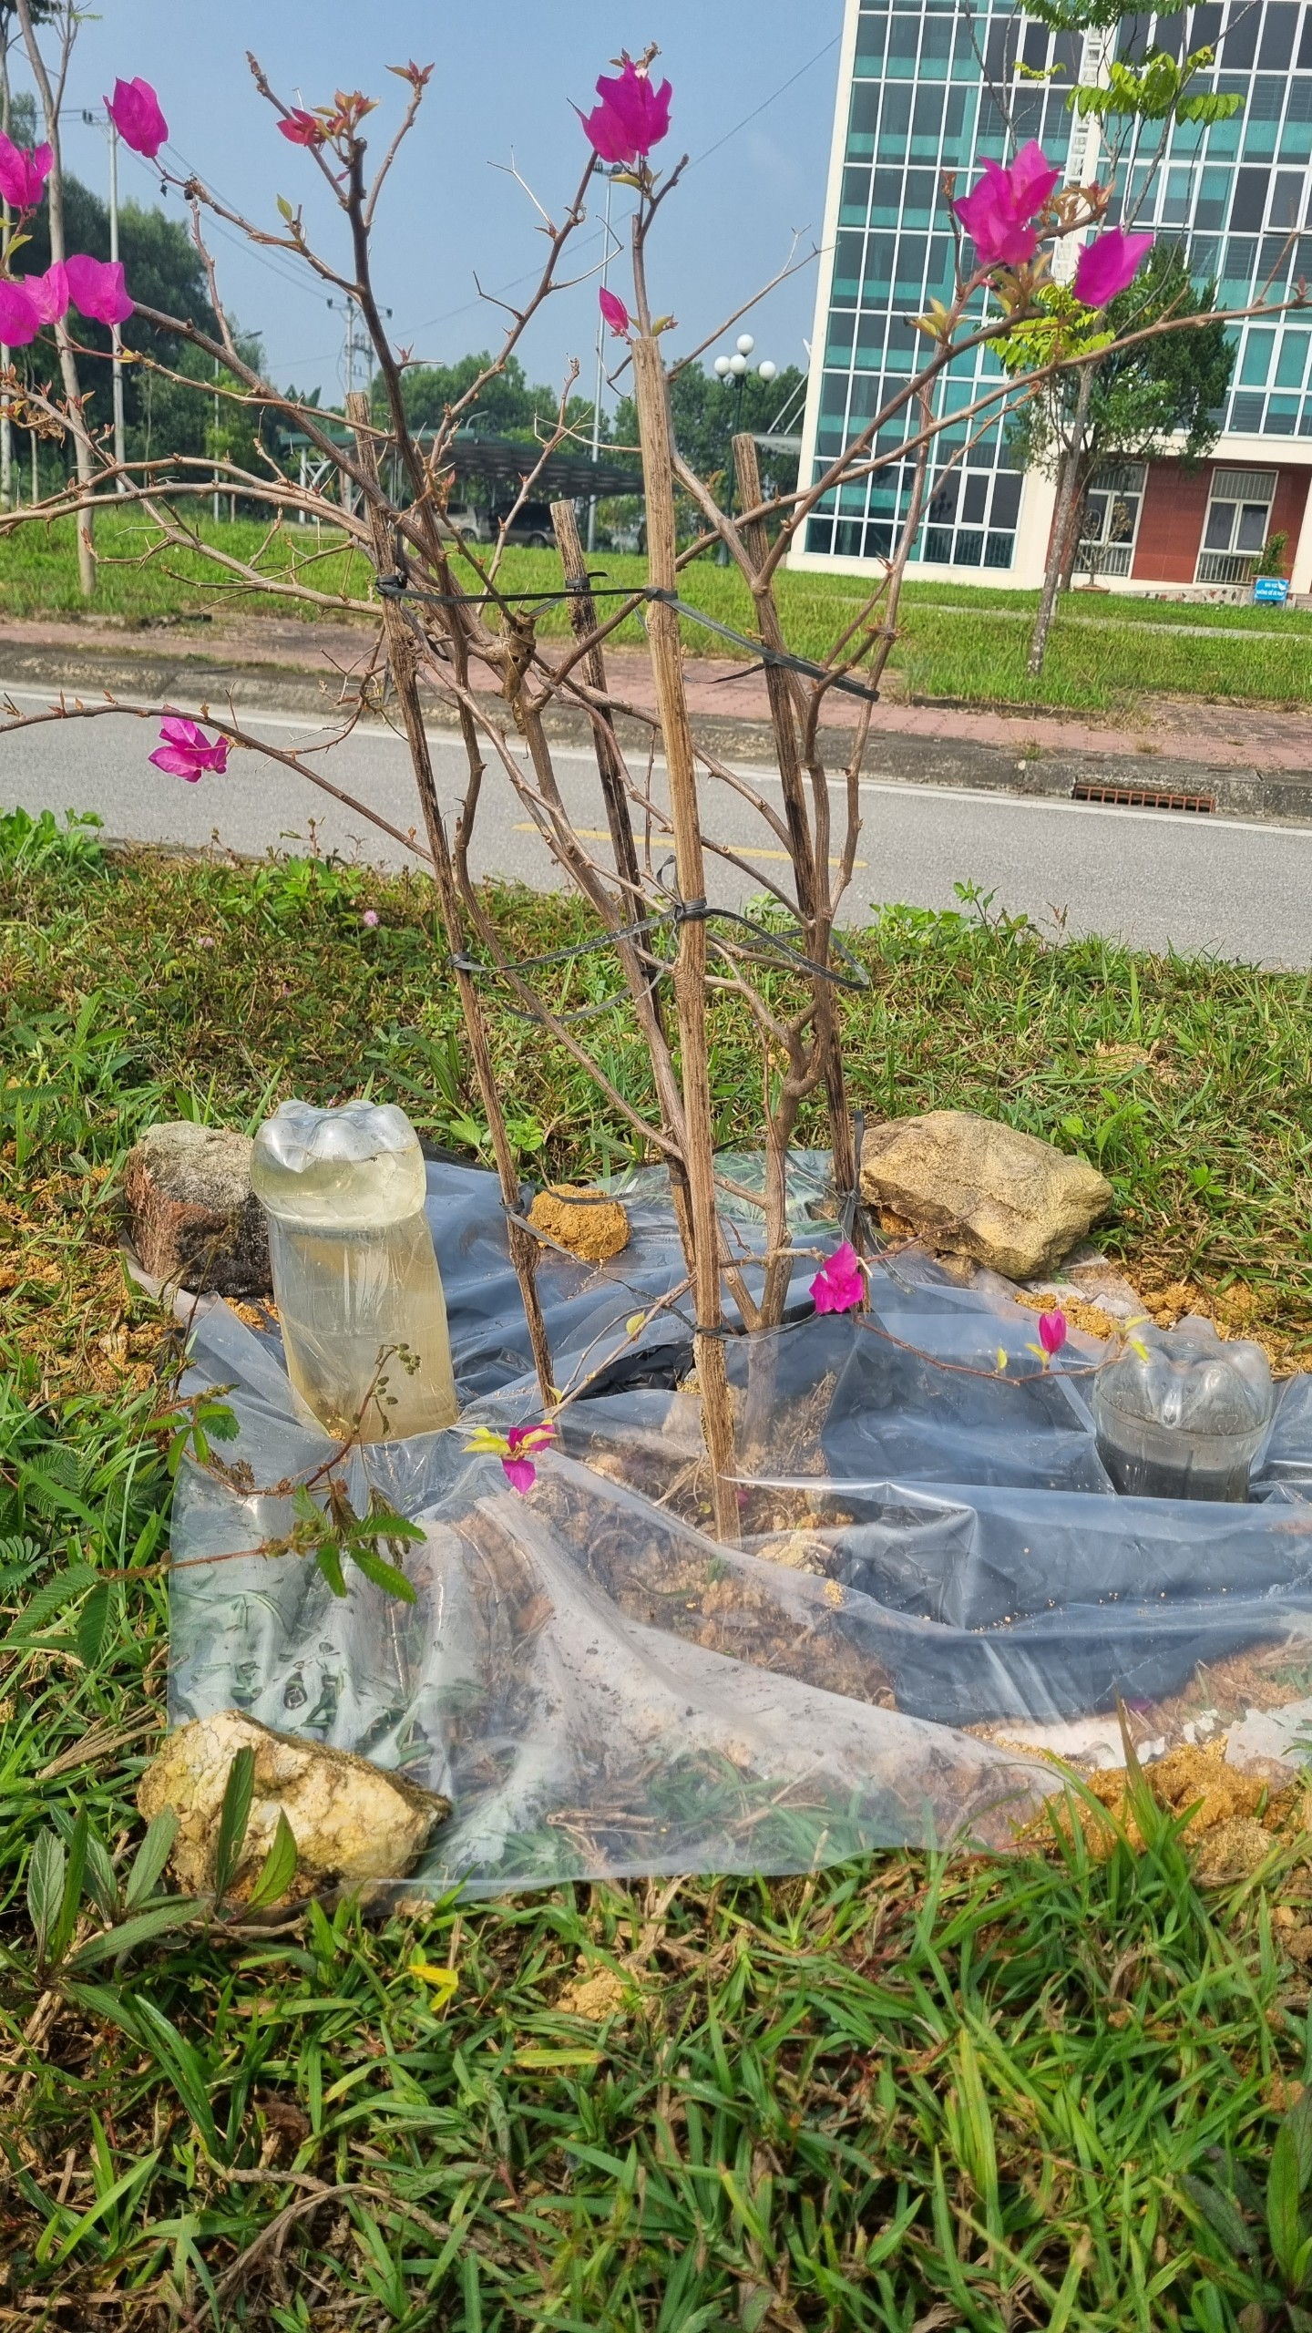
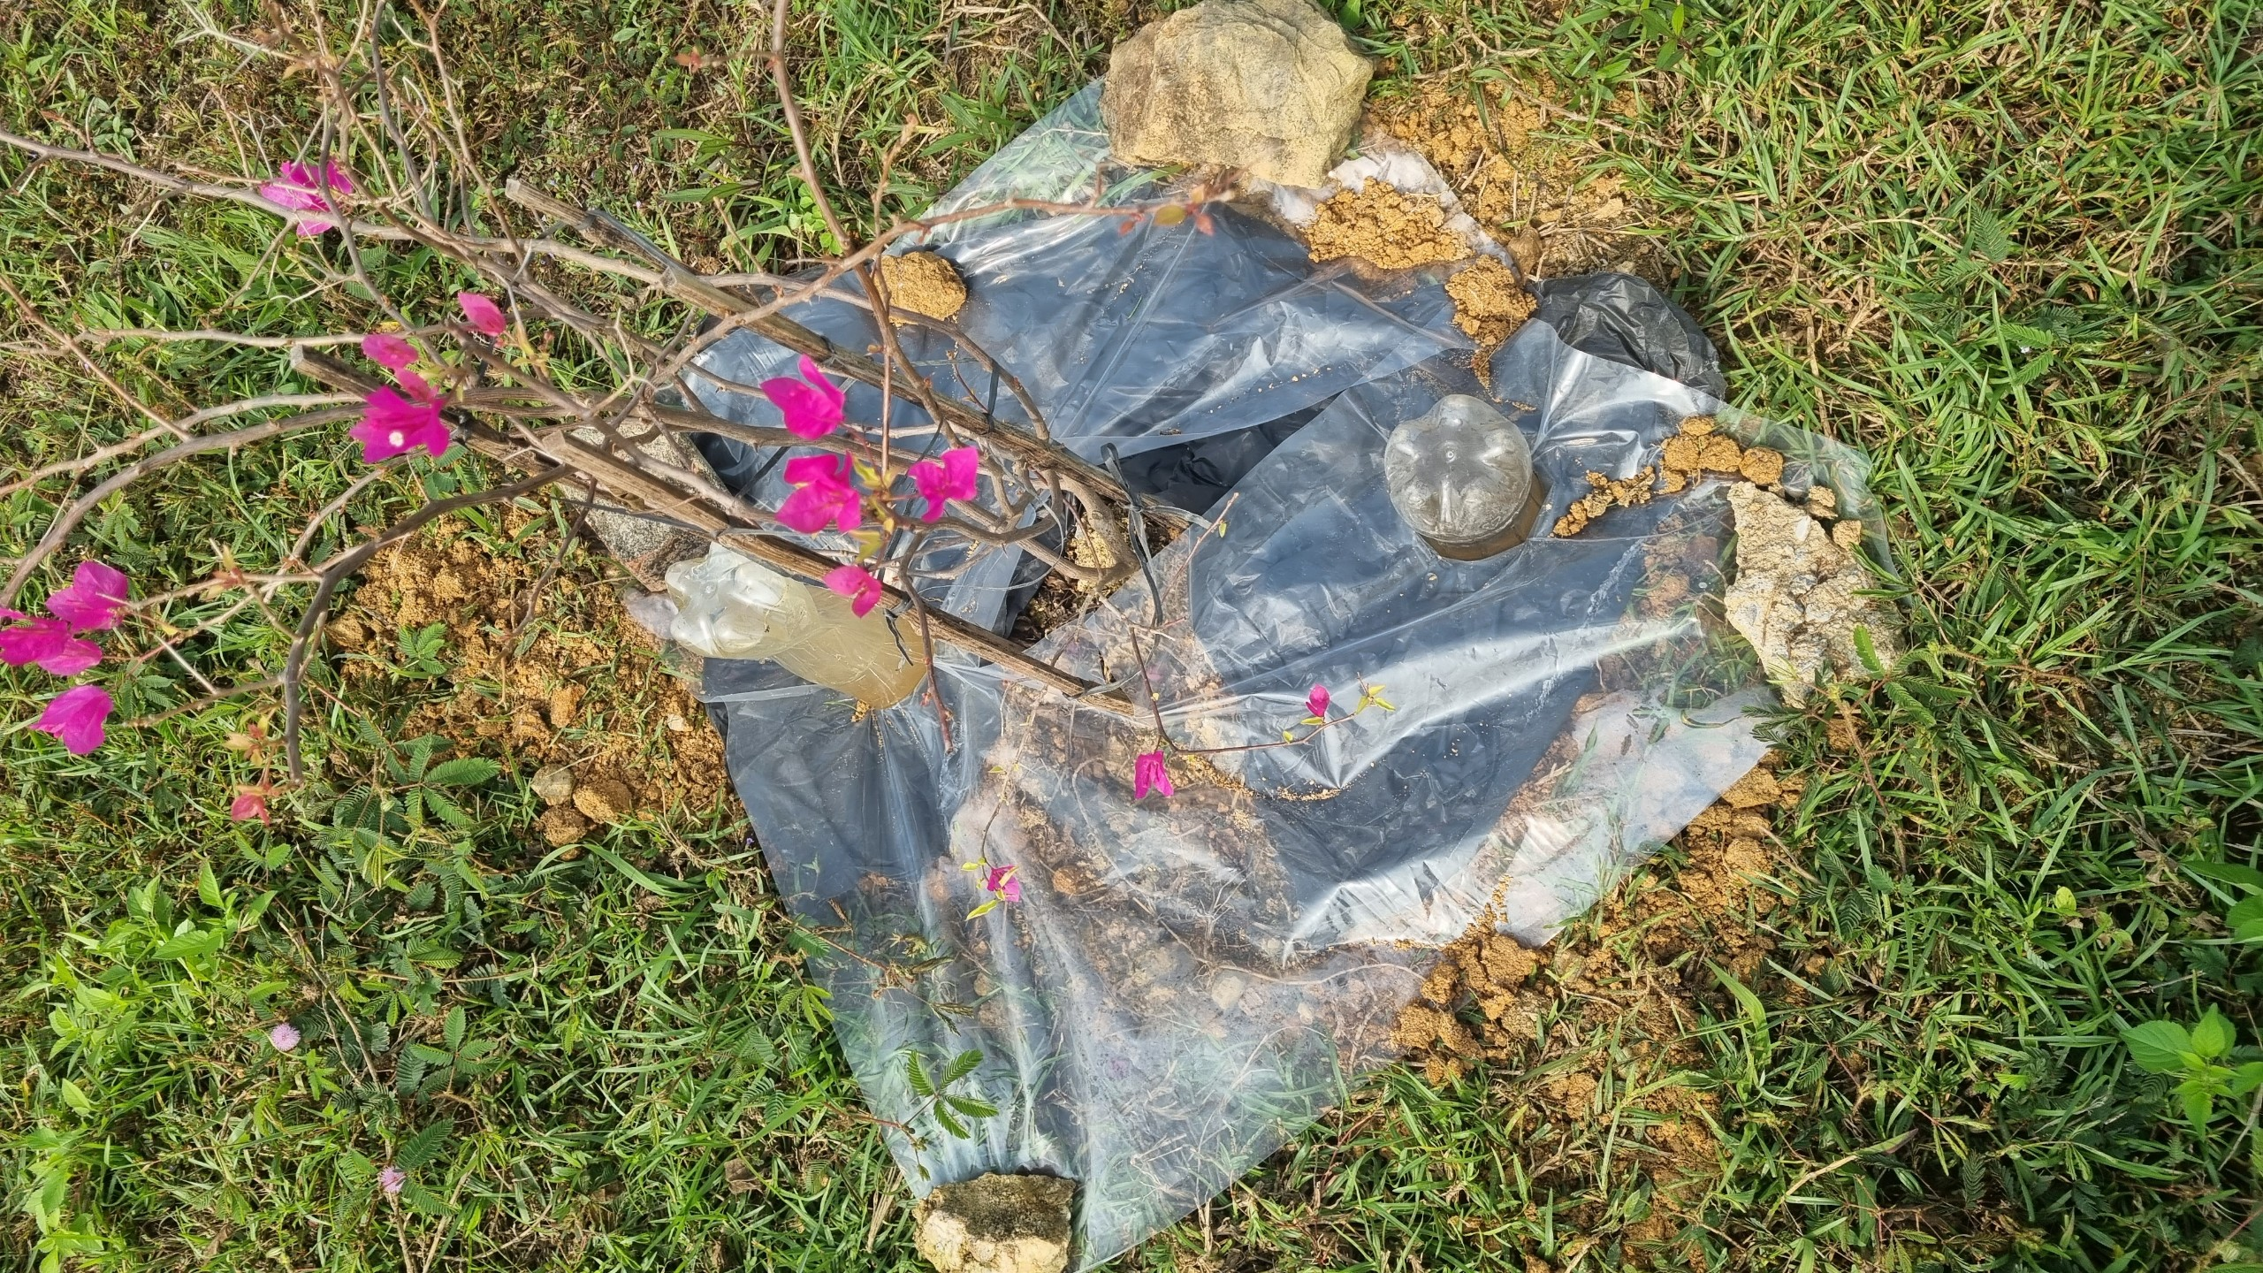
SOME PICTURES OF EXPERIMENTAL RESULTS

Slide 12
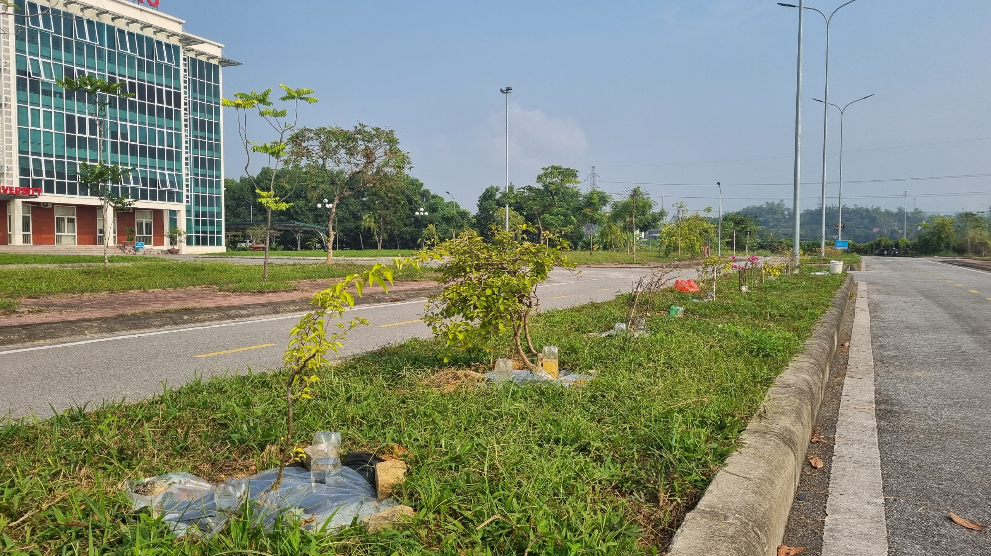
SOME PICTURES OF EXPERIMENTAL RESULTS

Slide 13
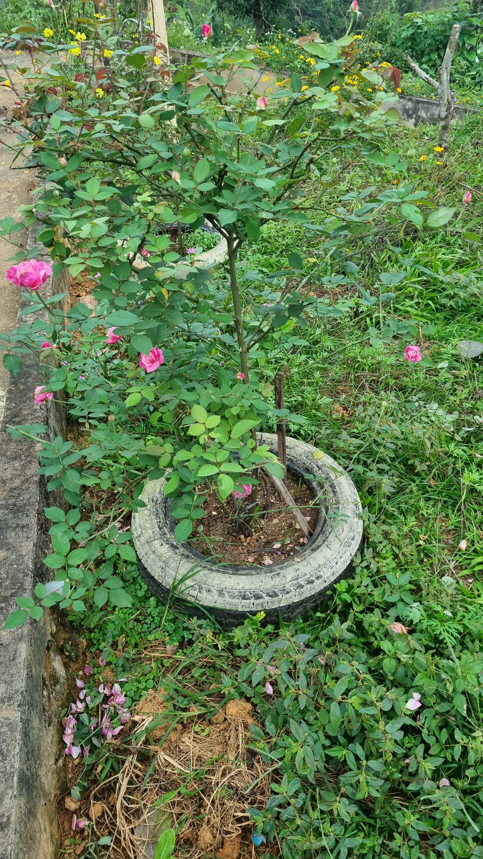
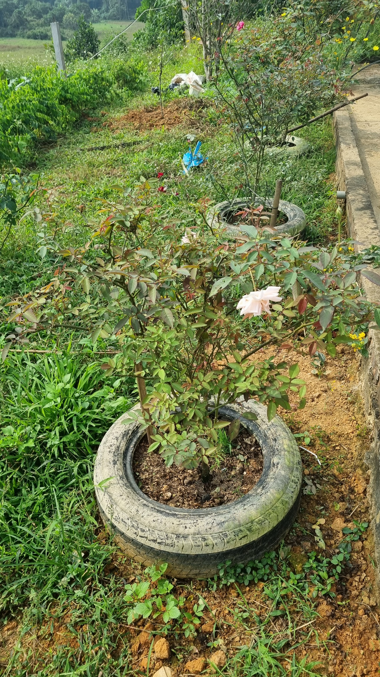
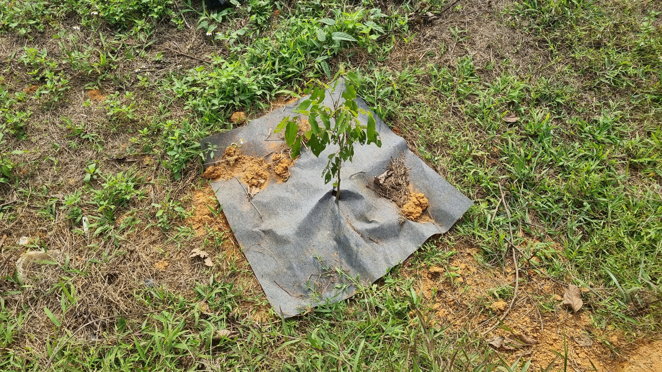
SOME PICTURES OF EXPERIMENTAL RESULTS

