Slide 1
COURSE: BUSINESS ANALYSIS
LIVING LAB PROJECT: BUSINESS OF LOCAL OCOP PRODUCTS
INSTRUCTOR | STUDENTS
ThS. Hoàng Anh Đào | Nguyễn Thị Thu Thảo Nguyễn Thị Khánh Ly Phạm Thị Ngọc Ánh Nguyễn Khánh Huyền Tướng Thị Son Trần Mỹ Hạnh Văn Thị Như Lan

Slide 2
Contents
goals
situations
products
solutions

Slide 3
Goals
Develop production and business of local OCOP products
OCOP: One Commune One Product

Slide 4
Situations
191
Products in OCOP rank
149
41
01

Slide 5
Situations
PCI₂₀₂₂
52/63
*Provincial Competitive Index

Slide 6
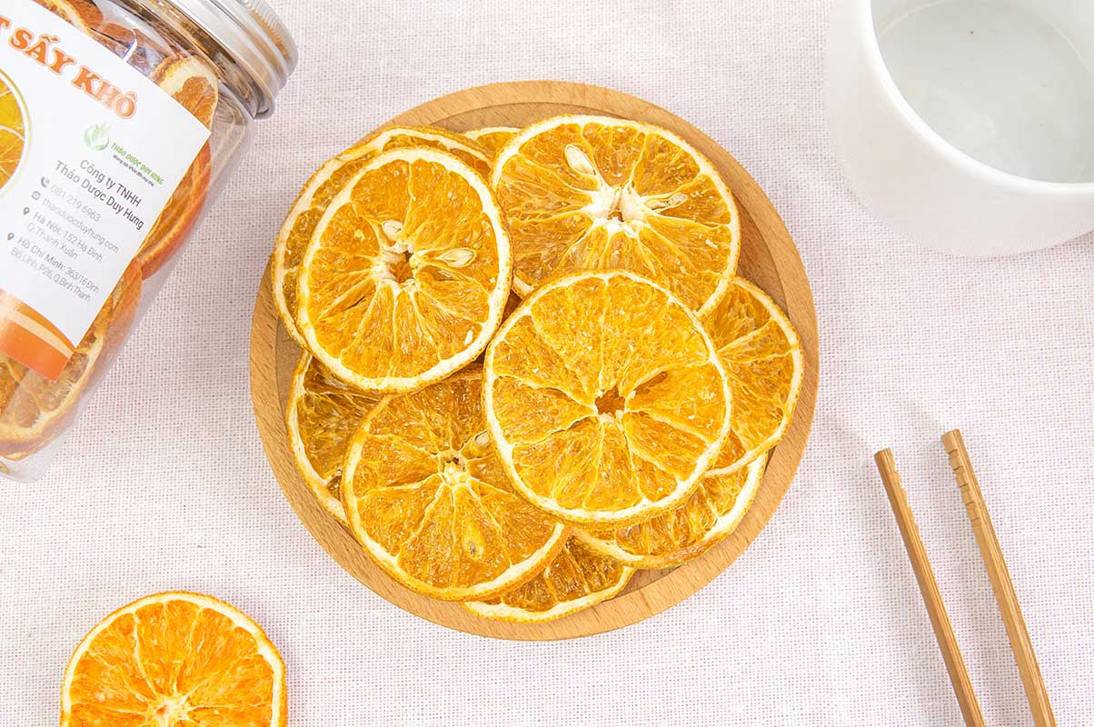
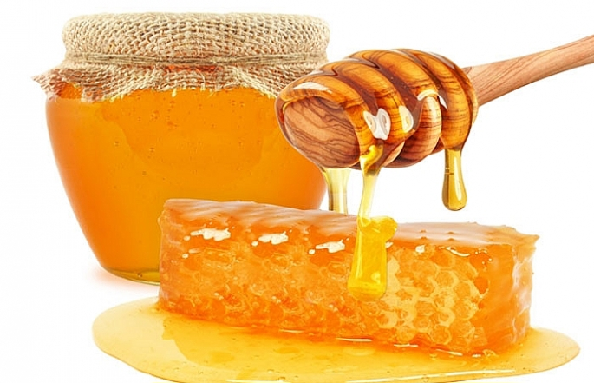
Products
OCOP
HONEYBEE
DRIED
ORANGE
TEA IN
BAMBOO TUBE

Slide 7
H1
H4
Importance.
Production and business plans
H2
Possibility
H5
Uniqueness and creativity
H3
H6
Marketing
Funding and Finance

Slide 8
TEA IN BAMBOO TUBE
MAIN PARTNER +Preliminary processing: Tea factory + Finished product: - Chain of agricultural stores, supermarkets, markets - Enterprises that trade and develop agricultural products | MAIN ACTIVITIES - Research about the quality and flavor of tea. - Production and distribution of Tea in Bamboo tube | VALUABLE SOLUTIONS - Bamboo tube tea is not only a drink but also a traditional gift containing unique cultural features - Tea helps purify the body, reduce blood sugar, and prevent diabetes at all ages; Helps keep the mind alert, reduces fatigue and dispels feelings of tension and stress. Besides, this tea is extremely good for the heart and liver. -Helps famers earn money to improve their life quality. | CUSTOMER RELATIONSHIP - Being a reliable partner, providing reputable and quality products - Provide useful information to customers about the product | CUSTOMER SEGMENT - Individual custormers - Agricultural product stores, supermarkets
 | RESOURCES + Natural resources - Tea growing land - Tea tree - Bamboo + Artificial resources - Skilled workers in processing tea - Tea processing machinery Fuel to dry tea
 | RESOURCES + Natural resources - Tea growing land - Tea tree - Bamboo + Artificial resources - Skilled workers in processing tea - Tea processing machinery Fuel to dry tea |  | DISTRIBUTION CHANNEL - Online marketing and promotion: facebook, website,... - Directly at stores, markets,... - Online commercial platforms: shopee, tiktok,...
COST STRUCTURE Fixed costs: - Cultivation costs: Seeds, fertilizers - Tools and supplies for harvesting and production - Check and verify product quality The variable costs - Costs of hiring workers to plant, care for, and harvest tea and tea plants, and labor to process and package products - Transportation costs - Marketing and product promotion costs. |  | REVENUE - Main revenue from: selling products - Others from tea gardens that want to promote tea products

Slide 9
HAM YEN DRIED ORANGE
MAIN PARTNER * Input: orange farms in Ham Yen district * Output - Supermarkets, agents, grocery stores, online shopping channels,... | MAIN ACTIVITIES Purchasing oranges, researching the production process and manufacturing dried oranges. | VALUABLE SOLUTIONS Purchasing oranges from farmers creating output for oranges, increasing the value of oranges and extending their preservation time. | CUSTOMER RELATIONSHIP - Build customers’ loyalty in purchasing large quantities of oranges for production. - Be a reliable partner for customers who are consumers of dried orange products. | CUSTOMER SEGMENT Mass strategy
 | RESOURCES Abundant labor resources: Take advantage of part-time students. The giant volume of oranges without distribution channel
 |  |  | DISTRIBUTION CHANNEL Direct channel : Customers buy products directly. Customer purchasing channels are through agents, supermarkets, grocery stores, etc. Customers buy onions through online shopping websites,...
COST STRUCTURE Fixed costs: + Warehouse rental costs + Cost of machinery, equipment and operating management software + Related tool and material costs The variable costs + Labor costs + Shipping costs + Marketing costs |  | REVENUE Main revenue from selling dried orange products.

Slide 10
OCOP HONEYBEE
MAIN PARTNER * Input - Local farmers direction. - Equipment manufacturer and beekeeping supplies. - Department of Agriculture and Rural development Tuyen Quang province. * Output - Consumers and enterprises in and outside Tuyen province Quang. - Physical stores products and local supermarkets direction. | MAIN ACTIVITIES - Purchasing honeybee from the local farmers: quality and origin guaranteed. - Processing and packaging honeybee to meet standards OCOP in terms of quality and preserve. - Building a campaign marketing to create awareness and promote interest from the customers. - Building a distribution system to food stores, supermarkets and individual customers. | VALUABLE SOLUTIONS - Guarantee about the quality of honey bee to meet the standards of OCOP - Provide training and instructions for farmers about farming techniques bees, harvesting and processing Honeybee. | CUSTOMER RELATIONSHIP - Create and maintain relationships with consumers, suppliers; Listen to their feedback, - Build a relationship with food and medicine stores, supermarkets - Cooperate with partners to expand market share. | CUSTOMER SEGMENT Mass strategy
 |  |  | DISTRIBUTION CHANNEL Direct channel : Customers buy products directly. Customer purchasing channels are through agents, supermarkets, medicine stores, etc. Customers buy onions through online shopping websites,...
 | RESOURCES Abundant labor resources Very large area of ​​natural forests and planted forests Diverse flowering plants produce exceptional honey quality
COST STRUCTURE Fixed costs: + Premises and facility rental costs + Technical support costs Variable costs: + Labors + Advertising and marketing costs + Shipping and distribution costs + Production costs + Packaging costs |  | REVENUE Main revenue from selling OCOP honeybee.

